Slide 1
Do Now: Answer the question below to the best of your ability.
Is there a right way and a wrong way to argue? How do we evaluate this?

Slide 3
Arguing from consequences is speaking for or against the truth of a statement by appealing to the consequences of accepting or rejecting it. Just because a proposition leads to some unfavorable result does not mean that it is false. Similarly, just because a proposition has good consequences does not all of a sudden make it true.

Slide 4
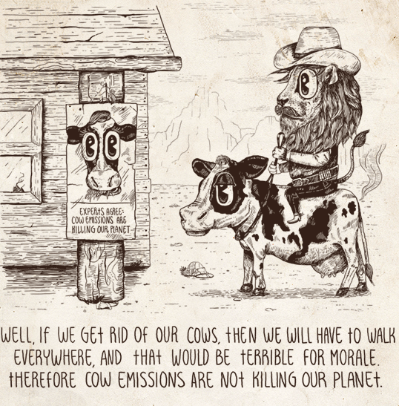
Arguing from Consequences

Slide 5
Straw Man
Intentionally caricaturing a person's argument with the aim of attacking the caricature rather than the actual argument is what is meant by “putting up a straw man.”

Slide 6
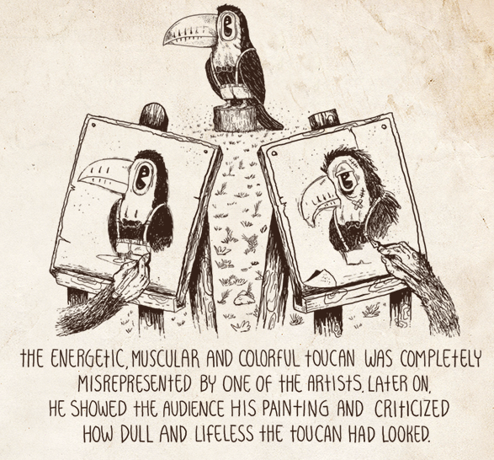
Straw Man

Slide 7
Appeal to Irrelevant Authority
An appeal to authority is an appeal to one's sense of modesty [Engel], which is to say, an appeal to the feeling that others are more knowledgeable. The overwhelming majority of the things that we believe in, such as atoms and the solar system, are on reliable authority, as are all historical statements, to paraphrase C. S. Lewis. One may reasonably appeal to pertinent authority, as scientists and academics typically do. An argument becomes fallacious when the appeal is to an authority who is not an expert on the issue at hand.

Slide 8
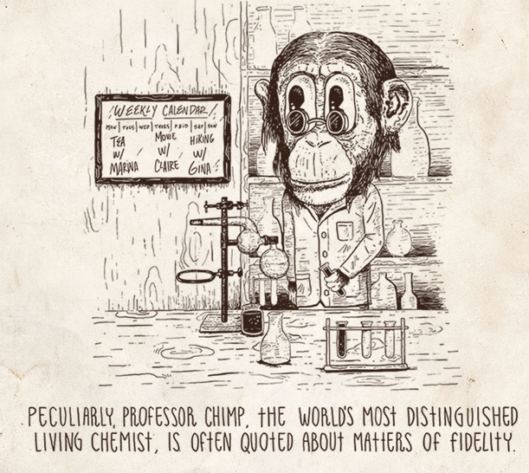
Appeal to Irrelevant Authority

Slide 9
Equivocation
Equivocation exploits the ambiguity of language by changing the meaning of a word during the course of an argument and using the different meanings to support some conclusion. A word whose meaning is maintained throughout an argument is described as being used univocally. Consider the following argument: How can you be against faith when we take leaps of faith all the time, with friends and potential spouses and investments? Here, the meaning of the word “faith” is shifted from a spiritual belief in a creator to a risky undertaking.

Slide 10
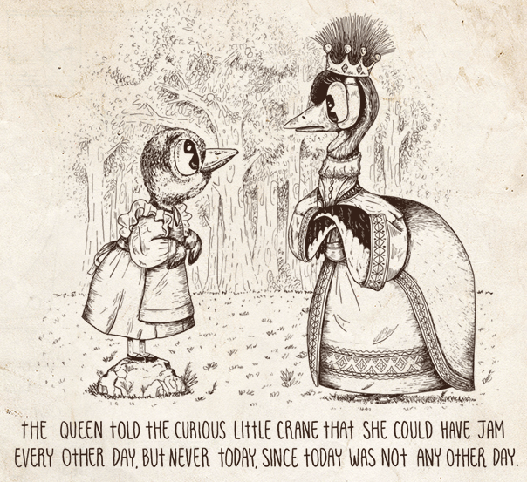
Equivocation

Slide 11
False Dilemma
A false dilemma is an argument that presents a set of two possible categories and assumes that everything in the scope of that which is being discussed must be an element of that set. If one of those categories is rejected, then one has to accept the other.

Slide 12
For example, In the war on fanaticism, there are no sidelines; you are either with us or with the fanatics. In reality, there is a third option, one could very well be neutral; and a fourth option, one may be against both; and even a fifth option, one may empathize with elements of both.

Slide 13
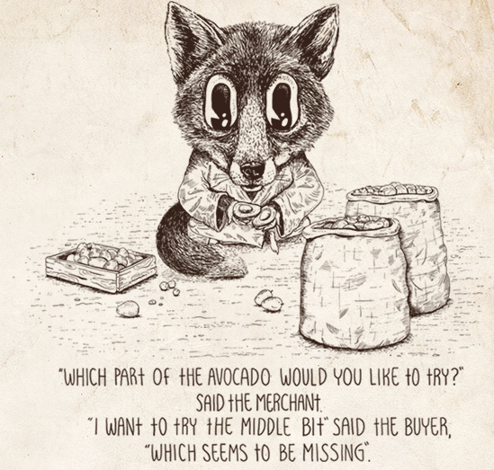
False Dilemma

Slide 14
Not a Cause for a Cause
The fallacy assumes a cause for an event where there is no evidence that one exists. Two events may occur one after the other or together because they are correlated, by accident or due to some other unknown event; one cannot conclude that they are causally connected without evidence. The recent earthquake was due to people disobeying the king is not a good argument.

Slide 15
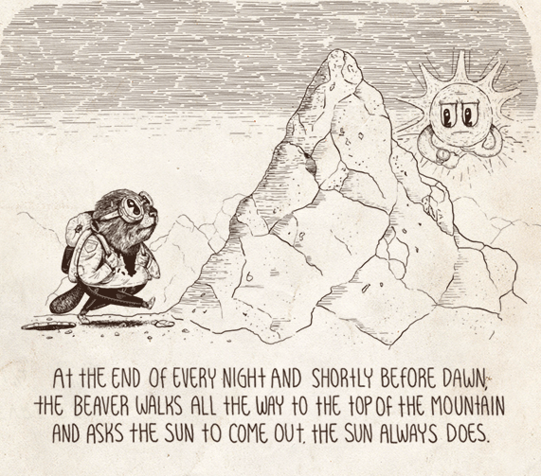
Not a Cause for a Cause

Slide 16
Appeal to Fear
The fallacy plays on the fears of an audience by imagining a scary future that would be of their making if some proposition were accepted. Rather than provide evidence to show that a conclusion follows from a set of premisses, which may provide a legitimate cause for fear, such arguments rely on rhetoric, threats or outright lies. For example, I ask all employees to vote for my chosen candidate in the upcoming elections. If the other candidate wins, he will raise taxes and many of you will lose your jobs

Slide 17
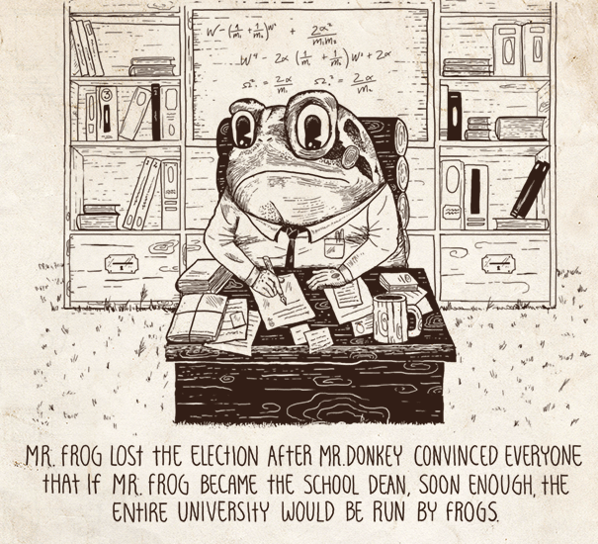
Appeal to Fear

Slide 18
Hasty Generalization
This fallacy is committed when one generalizes from a sample that is either too small or too special to be representative of a population. For example, asking ten people on the street what they think of the president's plan to reduce the deficit can in no way be said to represent the sentiment of the entire nation.

Slide 19
Hasty Generalization

Slide 20
Appeal to Ignorance
Such an argument assumes a proposition to be true simply because there is no evidence proving that it is not. Hence, absence of evidence is taken to mean evidence of absence., For example, when we did not know how the pyramids were built, some concluded that, unless proven otherwise, they must have therefore been built by a supernatural power. The burden-of-proof always lies with the person making a claim.

Slide 21
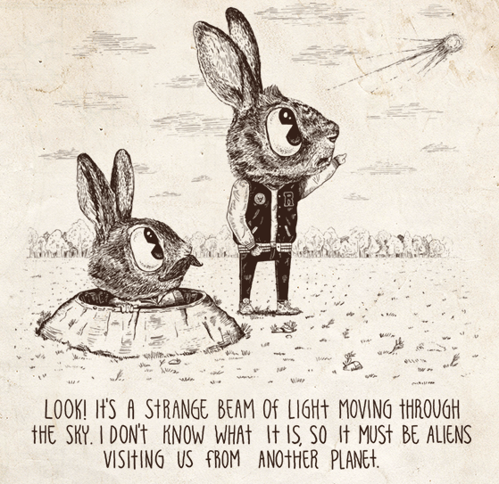
Appeal to Ignorance

Slide 22
No True Scotsman
A general claim may sometimes be made about a category of things. When faced with evidence challenging that claim, rather than accepting or rejecting the evidence, such an argument counters the challenge by arbitrarily redefining the criteria for membership into that category.⁶

Slide 23
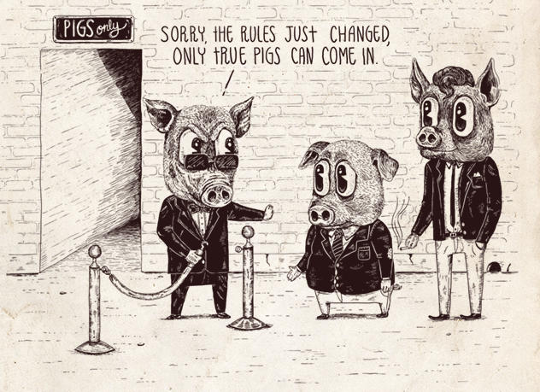
No True
Scotsman

Slide 24
Genetic Fallacy
A genetic fallacy is committed when an argument is either devalued or defended solely because of its history. An argument's origins or the origins of the person making it have no effect whatsoever on the argument's validity. Consider the following argument, Of course he supports the union workers on strike; he is after all from the same village. Here, rather than evaluating the argument based on its merits, it is dismissed because the person happens to come from the same village as the protesters.

Slide 25
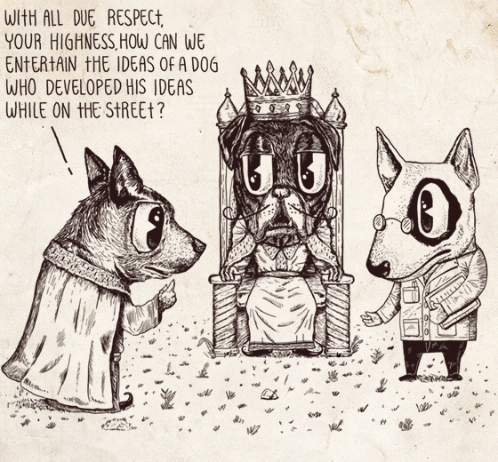
Genetic Fallacy

Slide 26
Guilt by Association
Guilt by association is discrediting an argument for proposing an idea that is shared by some socially demonized individual or group. For example, My opponent is calling for a healthcare system that would resemble that of socialist countries. Clearly, that would be unacceptable.

Slide 27
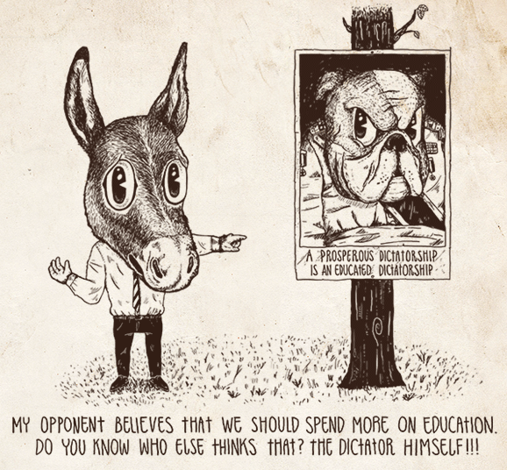
Guilt by Association

Slide 28
Affirming the Consequent
If A then C, C; hence A.
The error it makes is in assuming that if the consequent is true, then the antecedent must also be true, which in reality need not be the case. For example, People who go to university are more successful in life. John is successful; hence he must have gone to university. Clearly, John's success could be a result of schooling, but it could also be a result of his upbringing, or perhaps his eagerness to overcome difficult circumstances. More generally, one cannot say that because schooling implies success, that if one is successful, then one must have received schooling.

Slide 29
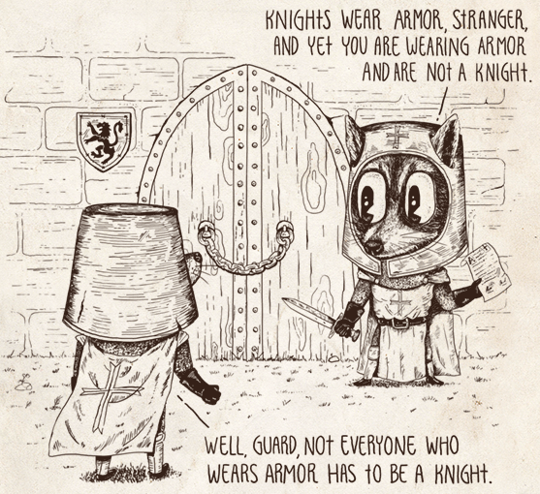
Affirming the Consequent

Slide 30
Appeal to Hypocrisy
This fallacy involves countering a charge with a charge, rather than addressing the issue being raised, with the intention of diverting attention away from the original argument. For example, John says, “This man is wrong because he has no integrity; just ask him why he was fired from his last job,” to which Jack replies, “How about we talk about the fat bonus you took home last year despite half your company being downsized.”

Slide 31
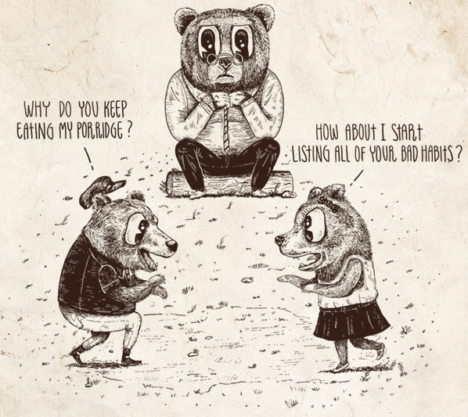
Appeal to Hypocrisy

Slide 32
Slippery Slope
A slippery slope⁷ attempts to discredit a proposition by arguing that its acceptance will undoubtedly lead to a sequence of events, one or more of which are undesirable. .

Slide 33
Slippery Slope

Slide 34
Appeal to the Bandwagon
Also known as the appeal to the people, such an argument uses the fact that a sizable number of people, or perhaps even a majority, believe in something as evidence that it must therefore be true. Some of the arguments that have impeded the widespread acceptance of pioneering ideas are of this type. Galileo, for example, faced ridicule from his contemporaries for his support of the Copernican model.

Slide 35
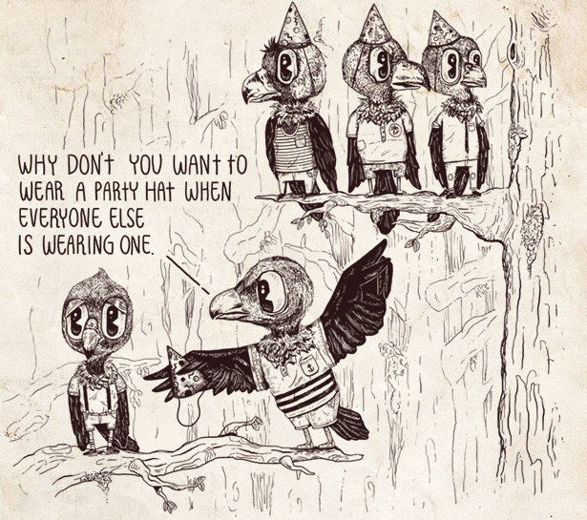
Appeal to the Bandwagon

Slide 36
Ad Hominem
An ad hominem argument is one that attacks a person's character rather than what he or she is saying with the intention of diverting the discussion and discrediting the person's argument. For example, You're not a historian; why don't you stick to your own field. Here, whether or not the person is a historian has no impact on the merit of their argument and does nothing to strengthen the attacker's position.

Slide 37
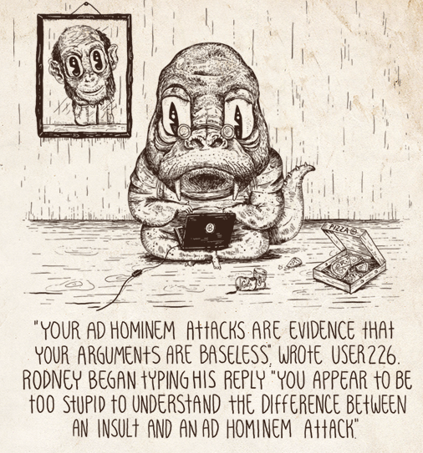
Ad Hominem

Slide 38
Homework:
Select three types of “Logical Fallacy” and create a statement followed by a type of fallacious response for each.
Due Friday 10/30

